Slide 1

DS-1 Project
TweetNiche: A tool for user niche exploration and analysis
Prepared By : Team Happy Whale
Aman Pawar Alvin Vinod Pratik Mukherjee Ojas Kulkarni

Slide 2

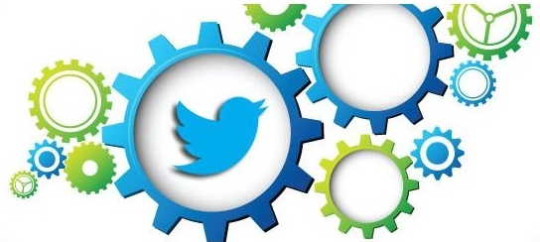

TABLE OF CONTENTS:
Introduction and Motivation about the project
Introduction to the Dataset and Data Scraping Methodologies
Data Visualizations
Recommendation System
Clustering Algorithms
Product Demonstration
Conclusion, Results & Future Scope

Slide 3

INTRODUCTION & MOTIVATION TO THE PROJECT
TweetNiche is a tool built for Twitter users & content creators looking to better understand the audience in their niche. Newbies to content creation often start out writing on a broad range of topics before finding a dedicated audience for a niche. Along the way, it is important to learn and understand various topics and explore several niche's before landing on one that works.
TweetNiche has two components: a recommender & a tweet analytics tool.
Often, a user's Twitter feed is filled with content from a wide range of the user's interest and it can be hard to study a niche. TweetNiche recommends tweets not only from user specified niche but also factoring it with user's own tweets to maintain the relevance to the user.
The user may expect a tweet to perform well however reality may be different. TweetNiche's tweet analytics tool can help study a tweet's performance by showing a user's tweet in relation to other tweets in the Niche that are most similar but more popular than the user's tweet.
Our dear friend Larry is on her voyage over the ocean of AI & Data Science and in order of get more related information in the domain help her build a recommendation system so that she can get the most related content of her favourite topics using twitter

Slide 4
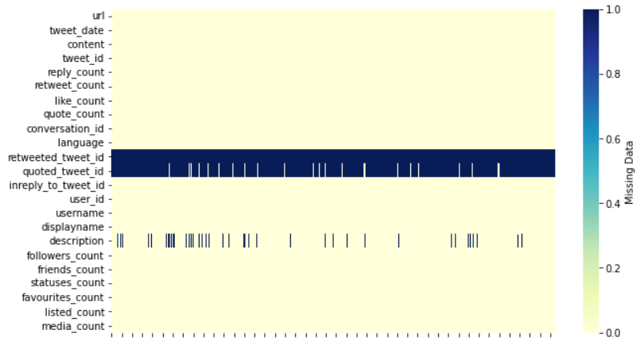
INTRODUCING THE DATASET & Scraping Method
01
Data is scraped from twitter using snscrape API.
02
The API allows extractions of tweets related to certain keywords and that posted by any user.
03
Using sns scrape we scraped 10,000 tweets, and used this data for our project development.

Slide 5

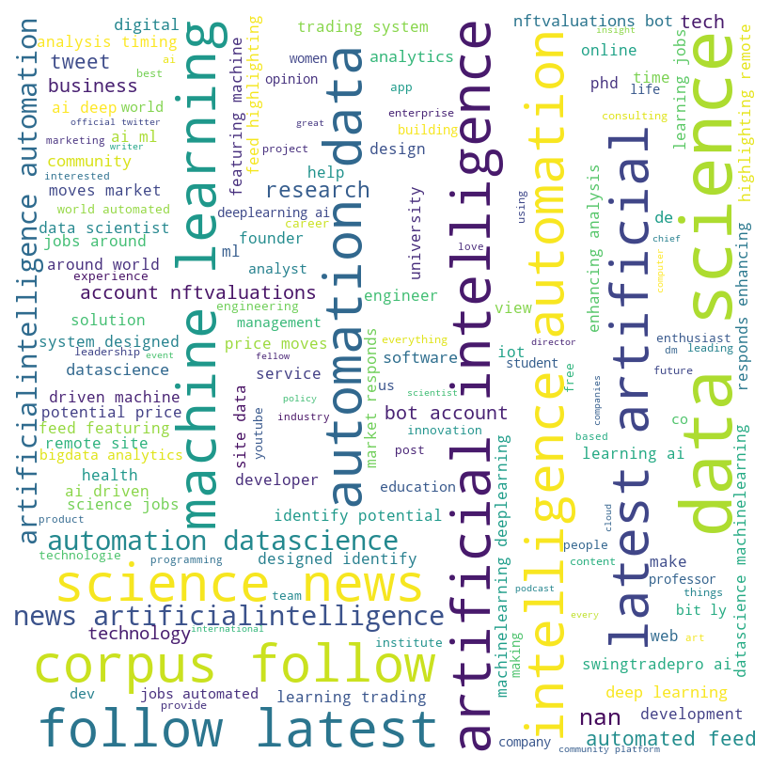
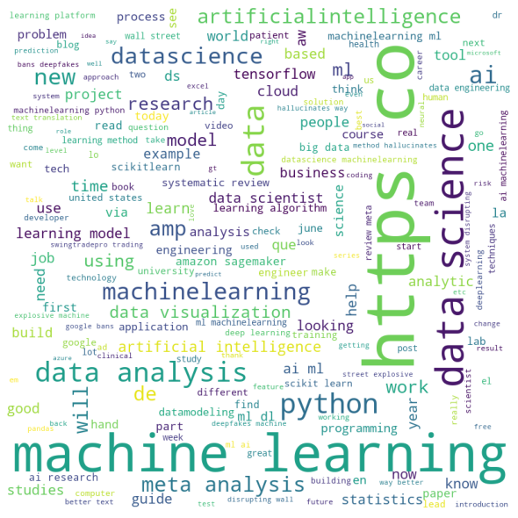
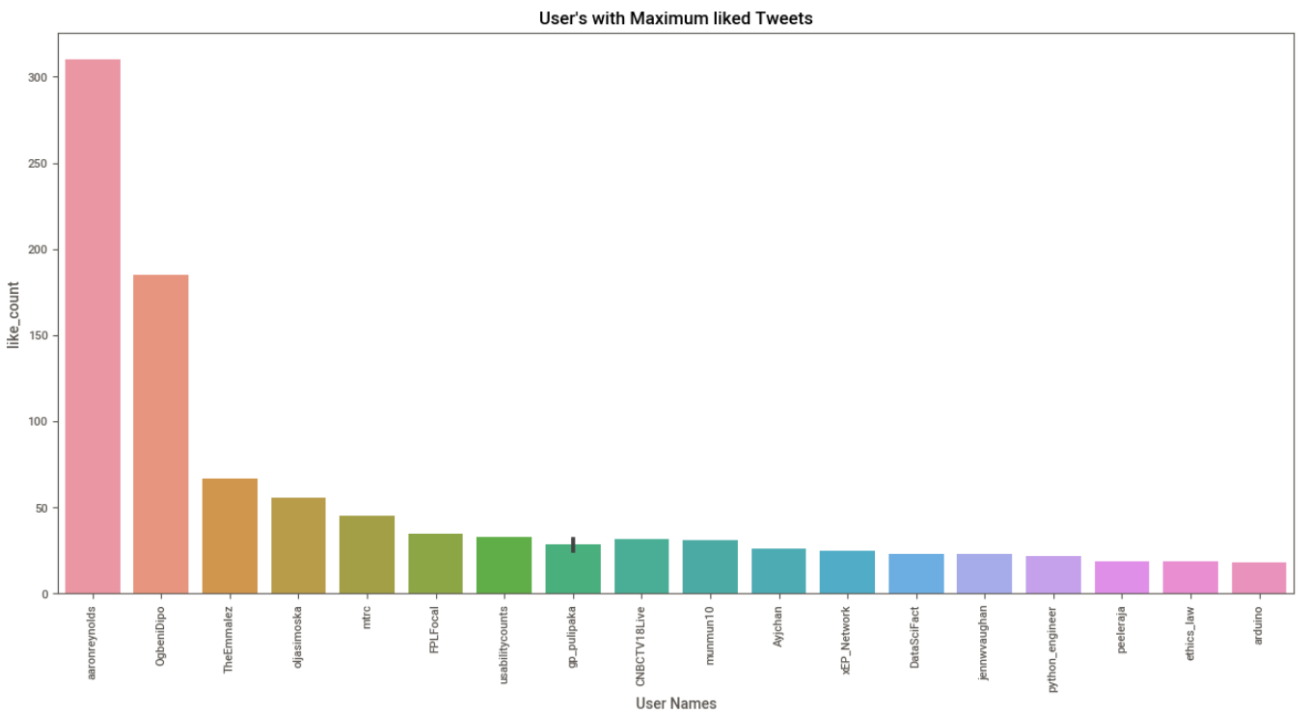
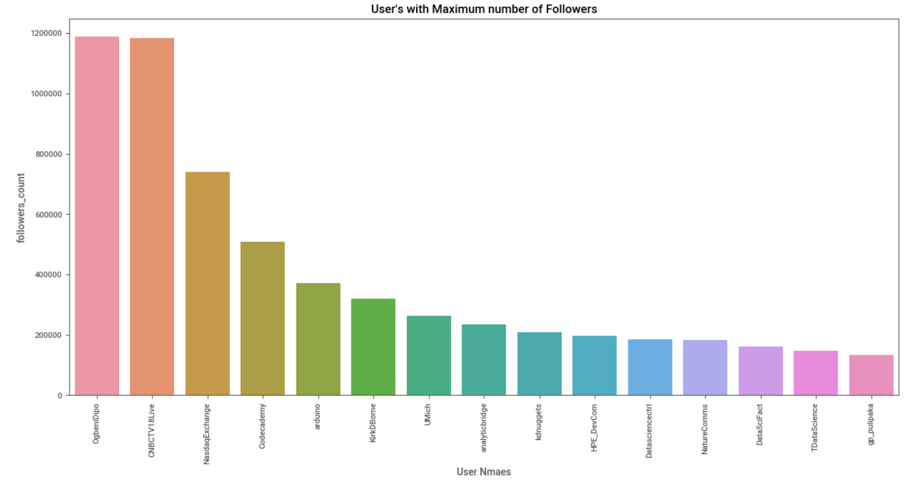
Data Visualization
User’s with Max liked Tweets
User’s with most followers

Slide 6
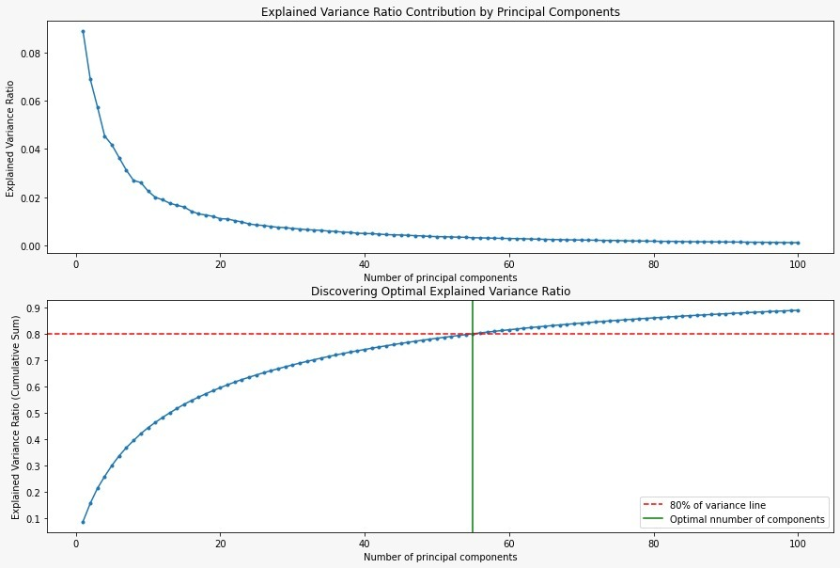
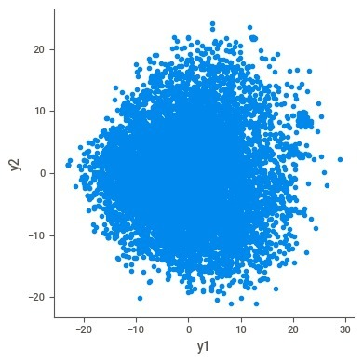
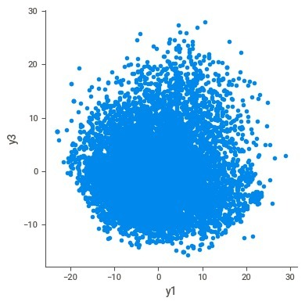
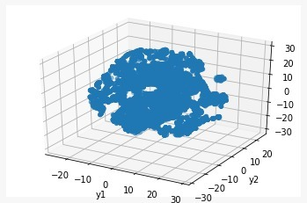
Principal Component Analysis
T-distributed stochastic neighbour Embedding
3d components of T-SNE

Slide 7
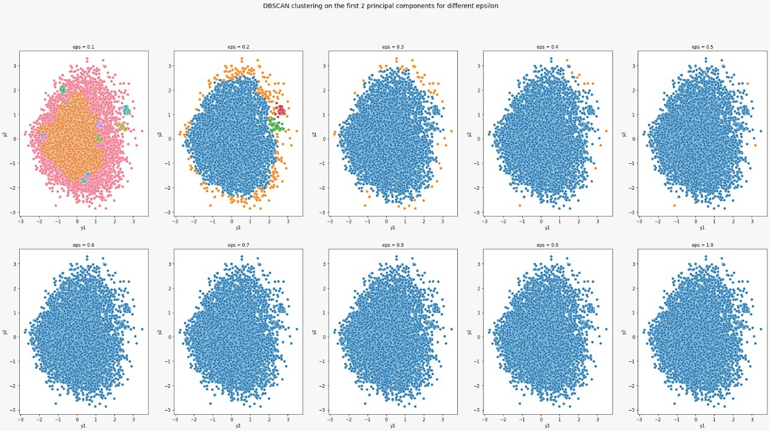
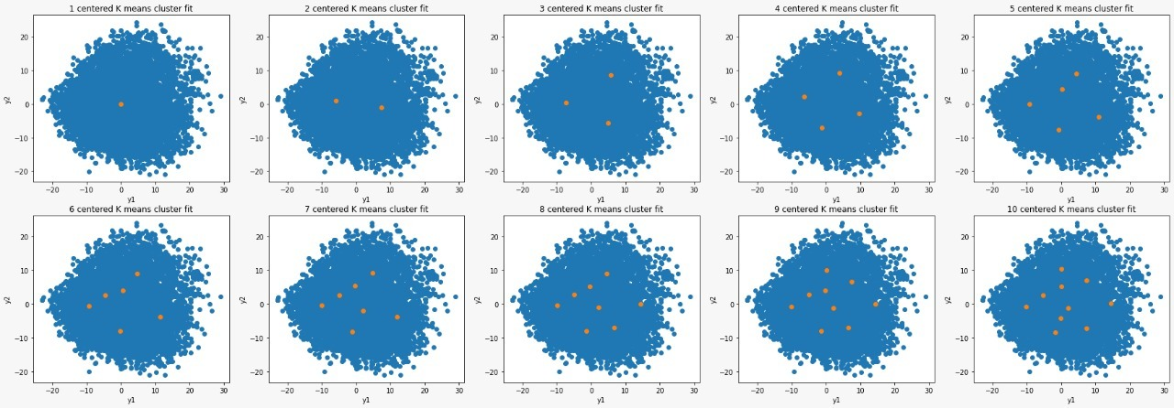
DBSCAN & K-Means Clustering
DBSCAN
k-Means

Slide 8

WALKTHROUGH TO THE INTERFACE of Recommendation System

Slide 9

RECOMMENDATION SYSTEM
Part I
1. Extract user's tweets and tweets based on user specified topic from Twitter using snscrape library.
2. Processes both sets of tweets to remove stop words and convert tweets into sentence embedding using a BERT-based model.
3. From the user-topic set of tweets find tweets that are most similar to the user's tweets and recommend.
Part II
1. Allow user to select one of his tweet and its relevant niche.
2. Extract and display top 10 most popular tweets in the niche that are also the most similar to the user's tweets.
3. Compare the tweet statistics of user's tweets with the top tweets in niche.

Slide 10
CONCLUSION & RESULTS
FUTURE SCOPE
The final recommender displays tweets based on cosine similarity. This has led to a few tweets which match on a few keywords only to sneak into the feed.
The user tweet based analytics displays more popular tweets that match the user's tweet. Few tweets that are extremely popular manage to rank up and move into the top 10 displayed tweets.
Using BERT based model for text embedding of tweets yielded better results compared to bare tf-idf vectorizer.
The final model was integrated into a pipeline and deployed on Heroku.
The topic vector can be improved with by choosing better language models and better queries can be formulated using context based keyword mapping.
A feedback mechanism can be built on top of the current interface for the user to report bad tweets and upvote useful tweets.
The popularity potential of a tweet can be predicted using user followers, performance of similar tweets in the past and additional factors.

Slide 11


THANK-YOU
TEAM HAPPY WHALE IS KEEN TO KNOW YOUR FEEDBACK

